Slide 1
Project Presentation On “Car Price Prediction” Presented By: Ajit Madame

Slide 2
Agenda
Problem Statement
Problem Understanding
Exploratory Data Analysis
Data Preprocessing Steps
Model Building
Interpretation of the Results
Hyperparameter Tuning
The Model Saving And Testing
Key Finding and Conclusions
Limitation of this works and Scope for Future Works

Slide 3
Problem Statements The proliferation of social media enables people to express their opinions widely online. However, at the same time, this has resulted in the emergence of conflict and hate, making online environments uninviting for users. Although researchers have found that hate is a problem across multiple platforms, there is a lack of models for online hate detection. Online hate, described as abusive language, aggression, cyberbullying, hatefulness and many others has been identified as a major threat on online social media platforms. Social media platforms are the most prominent grounds for such toxic behaviour. There has been a remarkable increase in the cases of cyberbullying and trolls on various social media platforms. Many celebrities and influences are facing backlashes from people and have to come across hateful and offensive comments. This can take a toll on anyone and affect them mentally leading to depression, mental illness, self-hatred and suicidal thoughts. Internet comments are bastions of hatred and vitriol. While online anonymity has provided a new outlet for aggression and hate speech, machine learning can be used to fight it. The problem we sought to solve was the tagging of internet comments that are aggressive towards other users. This means that insults to third parties such as celebrities will be tagged as unoffensive, but “u are an idiot” is clearly offensive.

Slide 4
Problem Understanding Online forum and social media platforms have provided individuals with the means to put forward their thoughts and freely express their opinion on various issues and incident. In some cases, these online comments contain explicit language which may hurt the readers. Comments containing explicit language can be classified into myriad categories such as Malignant, Highly Malignant, Rude, Threat, Abuse and Loathe. The threat of abuse and harassment means that people stop expressing themselves and give up on seeking different opinions. To protect users from being exposed to offensive language on online forums or social media sites, companies have started flagging comments and blocking users who are found guilty of using unpleasant language. Several Machine Learning models have been developed and deployed to filter out the unruly language and protect internet users from becoming victims of online harassment and cyberbullying.

Slide 5
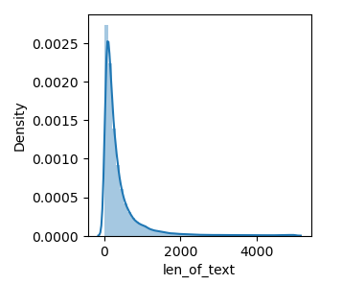
Exploratory Data Analysis Univariate Analysis Observation We can see, up to 2000 words comment test are used. It seems to be people are used so many malignant words while commenting.

Slide 6
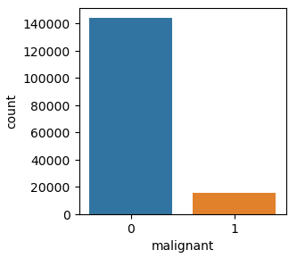
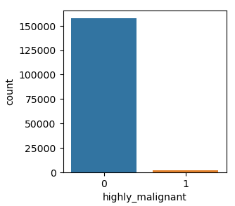
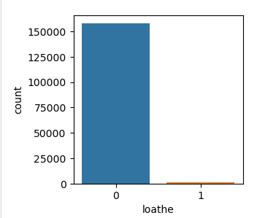
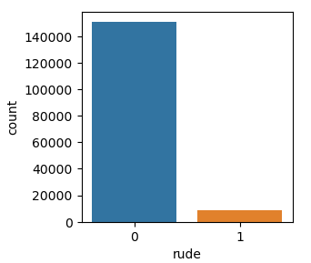
Observation - We can see, in malignant categories of comment there are having less malignant comment. 1 has low count than 0 it means that0 may be normal comment 1 may be malignant. - In Highly malignant 1 has less than 0 it meant that there is less highly malignant word using by users. But their magnitude is high because it may cause the depression to others users. - In loathe, there is also low percentage of 1 category. - In rude categories, rude comment is high than others categories so it may cause another user.

Slide 7
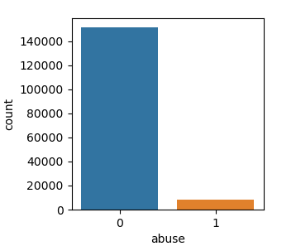
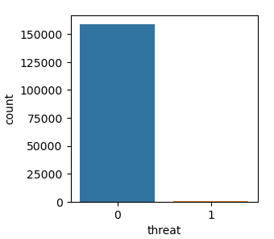
Observation - Rude and Abuse is having almost same quantity of comment but their magnitude or impact will be different. Rude has low impact than abuse comment. - We can see, there is also threat comment but their ration very small but it may have very large impact.

Slide 8
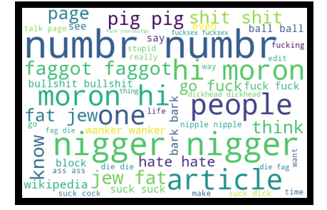
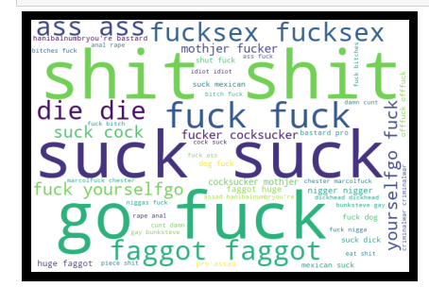
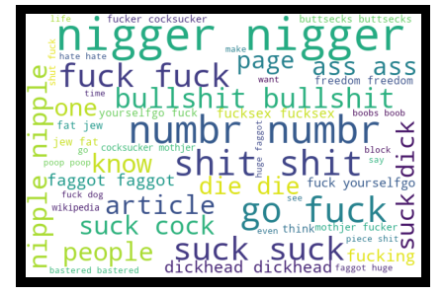
Word Cloud Analysis Observation - We can see, so many malignant comments are used by users which show in above. Pig, wanker, hate, die and shit these are the word are mostly used. - The vocabulary used in all categories is quite similar (expect for 'none' of course). Frequencies are varying a bit across (for example 'fuck' and 'suck'.

Slide 9
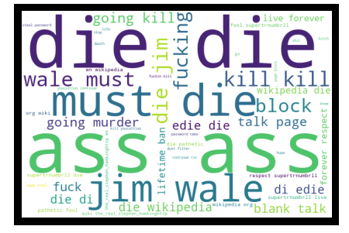
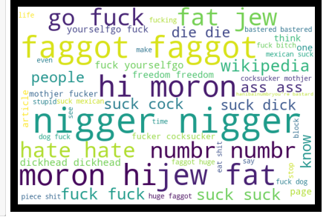
Observation - We can see, ass, Jim, wale, fucking, die and going kill these are the word are mostly used by users for threatening the another’s users. Due to this impact of threat massages will causes several risks to users so we need to improve the social media to make user friendly. - There are so many words are used by user for abusing someone. like, faggot, fuck, Morongo, suck, and jew. Here also have highly malignant word also.

Slide 10
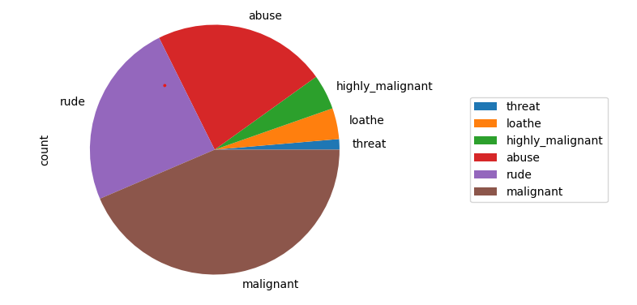
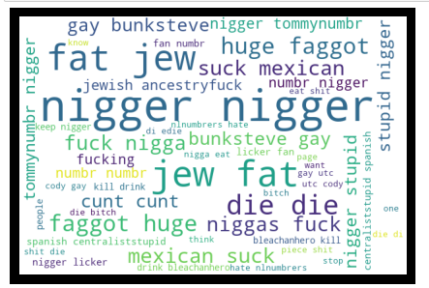
Observation - We can see loathe comment where so many word are used for commenting on others some of is nigger, die, gay, Mexican, stupid these words are used to loathe the people or users. - We can see, malignant is having maximum comment than others categories followed by rude. Threat categories comment is having low count but it has high impact than others. Highly malignant comments are having high impact on user whose face such problem.

Slide 11
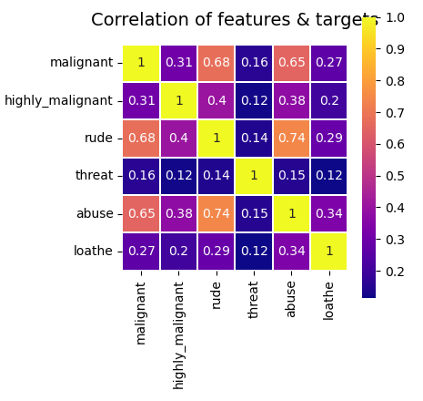
Correlation of the features with target columns Observation Indeed, it looks like some of the labels are higher correlated, e.g., abuse-rude has the highest at 0.74, followed by malignant-rude and malignant-abuse.

Slide 12
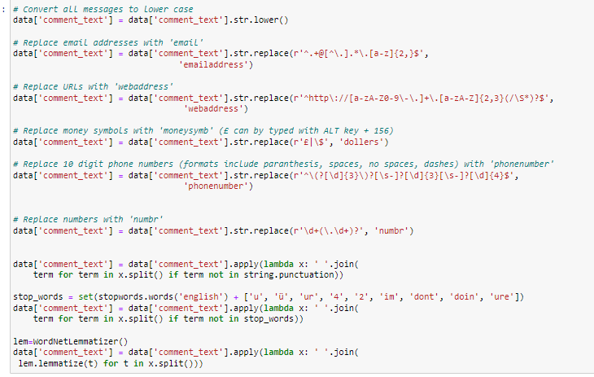
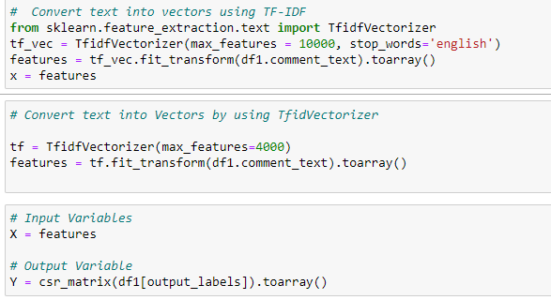
Model Building

Slide 13
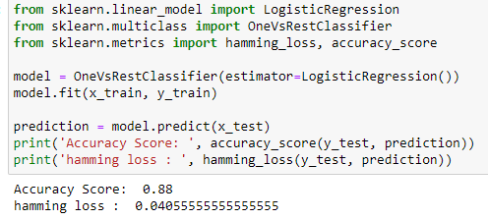
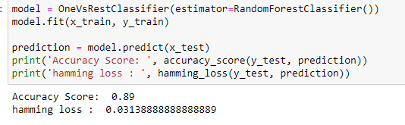
Logistic Regression Random Forest Classifier

Slide 14
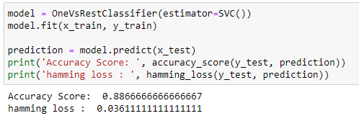
Support Vector Classifier Interpretation of Result Based on comparing Accuracy Score results with hamming loss results, it is determined Random Forest Classifier is the best model. It has least difference between accuracy score and hamming loss.

Slide 15
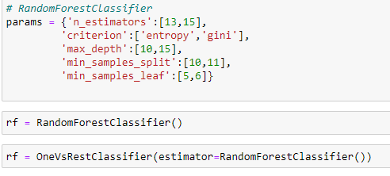
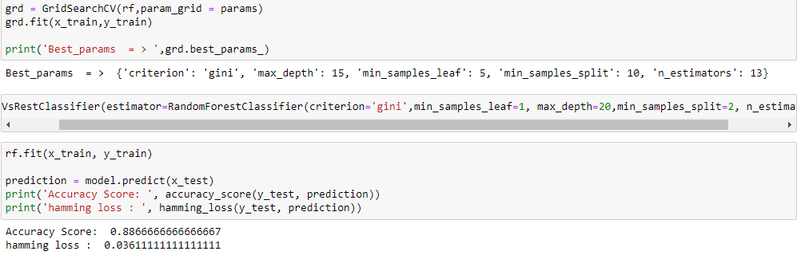
Hyperparameter Tuning

Slide 16
Key Finding and Conclusions The finding of the study is that only few users over online use unparliamentary language. And most of these sentences have more stop words and are being quite long. As discussed before few motivated disrespectful crowds use these foul languages in the online forum to bully the people around and to stop them from doing these things that they are not supposed to do. Our study helps the online forums and social media to induce a ban to profanity or usage of profanity over these forums.

Slide 17
Limitation of this work and scope for future Problems faced while working in this project: More computational power was required as it took more than 2 hours Imbalanced dataset and bad comment texts Good parameters could not be obtained using hyperparameter tuning as time was consumed more Areas of improvement: Could be provided with a good dataset which does not take more time. Less time complexity Providing a proper balanced dataset with less errors.

Slide 18


